Slide 1

Teaching Plan
MA2011 Module I
Dr Yiyu CAI
Instructor, Module 1
Jan 2024

Slide 2
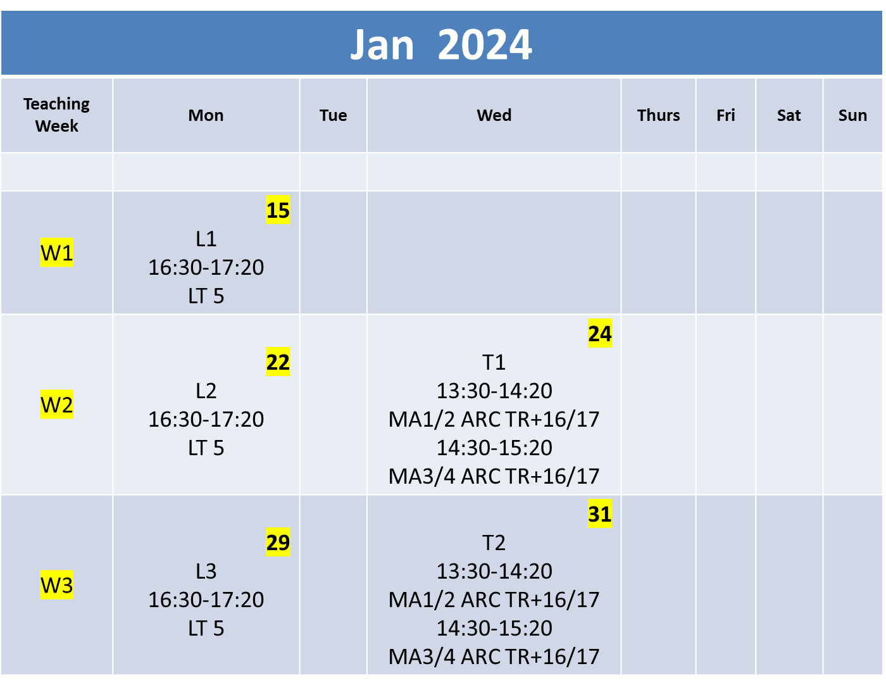

Slide 3
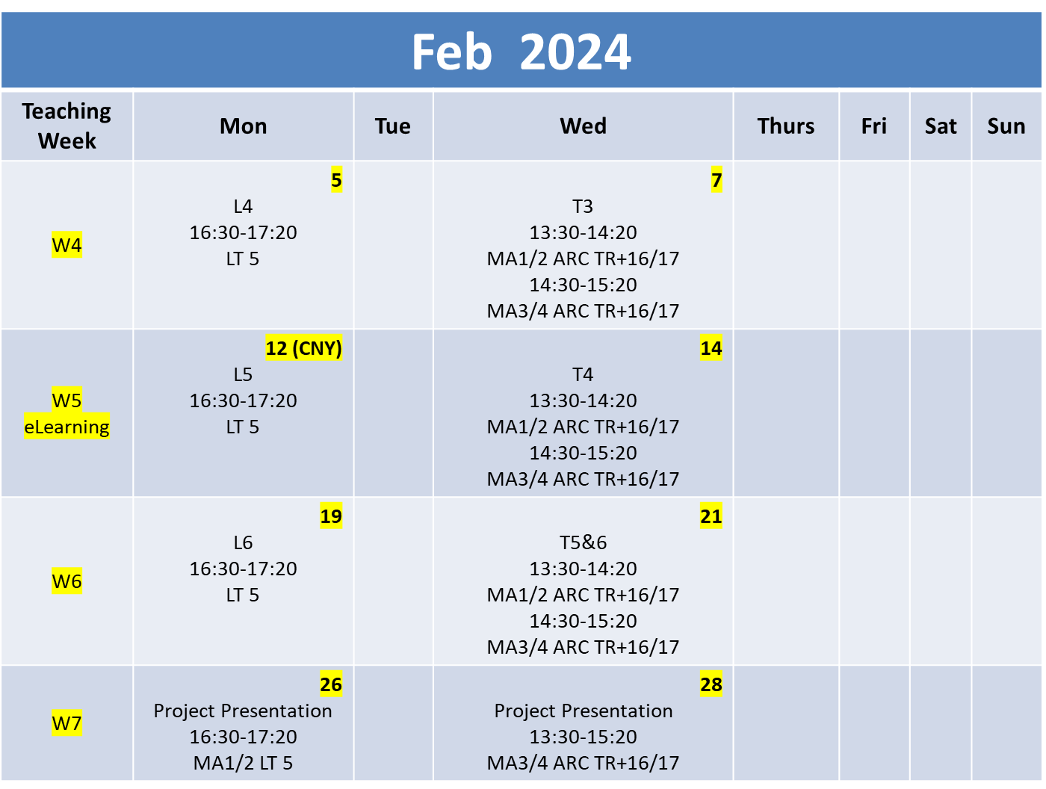

Slide 4
Lectures
Lecture # | Topic | Remark
1 | SYSTEM RESPONSE | Week 1
2 | FOURIER SERIES THEORY | Week 2
3 | DYNAMIC SYSTEM RESPONSE | Week 3
4 | SAMPLING | Week 4
5 | ANALOG SIGNAL PROCESSING USING OPERATIONAL AMPLIFIERS | Week 5
6 | A/D CONVERSION | Week 6

Slide 5
Tutorials
Tutorial # | Topic | Remark
1 | SYSTEM RESPONSE (Lecture 1) | Week 2
2 | FOURIER SERIES THEORY (Lecture 2) | Week 3
3 | DYNAMIC SYSTEM RESPONSE (Lecture 3) | Week 4
4 | SAMPLING (Lecture 4) | Week 5
5 | ANALOG SIGNAL PROCESSING USING OPERATIONAL AMPLIFIERS (Lecture 5), and A/D CONVERSION (Lecture 6) | Week 6

Slide 6
Tutorials/Project Teaming
Group # | Teaming |  | Remark
MA1/2 | MA1 | MA1-1: | Max 4 persons per team
 |  | MA1-2:
 |  | MA1-3:
 |  | MA1-4:
 |  | MA1-5:
 |  | MA1-6:
 |  | MA1-7:
 |  | MA1-8:
 | MA2 | MA2-1:
 |  | MA2-2:
 |  | MA2-3:
 |  | MA2-4:
 |  | MA2-5:
 |  | MA2-6:
 |  | MA2-7:
 |  | MA2-8:
MA3/4 | MA3 | MA3-1:
 |  | MA3-2:
 |  | MA3-3:
 |  | MA3-4:
 |  | MA3-5:
 |  | MA3-6:
 |  | MA3-7:
 |  | MA3-8:
 | MA4 | MA4-1:
 |  | MA4-2:
 |  | MA4-3:
 |  | MA4-4:
 |  | MA4-5:
 |  | MA4-6:
 |  | MA4-7:
 |  | MA4-8:

Slide 7
Tutorials – Hybrid Mode
Tutorial # (Week) | Topic | ARC TR+16 | ARC TR+17
1 (Week 2) | SYSTEM RESPONSE (Lecture 1) | MA1 | MA2
 |  | MA3 | MA4
2 (Week 3) | FOURIER SERIES THEORY (Lecture 2) | MA1 | MA2
 |  | MA3 | MA4
3 (Week 4) | DYNAMIC SYSTEM RESPONSE (Lecture 3) | MA1 | MA2
 |  | MA3 | MA4
4 (Week 5) | SAMPLING (Lecture 4) | eLearning | eLearning
 |  | eLearning | eLearning
5/6 (Week 6) | ANALOG SIGNAL PROCESSING USING OPERATIONAL AMPLIFIERS (Lecture 5), and A/D CONVERSION (Lecture 6) | MA1 | MA2
 |  | MA3 | MA4

Slide 8
Project
Week # | Topic | Remark
1 | Completion of Project Teaming | Max 4 in a team (same team for tutorial)
2 | Announcement of Project | Project Kick Start
3 | Project Time | Part of the Lecture time allocated will be used for project discussion
4
5
6
7 | Project Presentation | By end of Week 7, each team has to submit a video presentation at NTULearn

Slide 9
About The Project
More detail will be given next week
Design of Digital Twin for Smart X
Teaming: Max 4 people

Slide 10
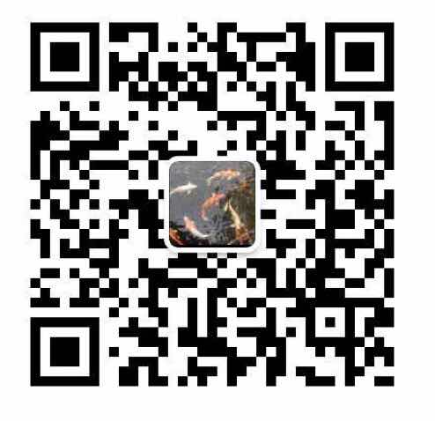
MA2011
Contact me
Office: N3.2-01-08
Tel: 67905777 Cell: 90290242
Email: myycai@ntu.edu.sg
Wechat: YCaiSG
MA2011 WeChat or Whatsapp Groups (TBF)

